Slide 1
Thesis Images

Slide 2
Introduction

Slide 3
1.1 - CL TNBC
Better explain immune response characteristic of CL
There are targeted therapies now!

Slide 4
1.2 – Tumor Reversion
Include sentence about immunotherapy in addition to conventional therapies
Justification of cell line choices

Slide 5
1.3 – 1.5
Control Methods using Dynamics or Structure and Dynamics
Network Topology
Genes/Proteins/Molecules
Regulatory Edges sans Dynamics
Identify Control Targets
Multi-Omics Data
Literature Evidence
Experiments
Identify Successful Concerted Perturbations of Control Targets
Dynamical Model
System Dynamics
ODEs w/ Kinetic Parameters
Logic Formalisms
Simulate Using Model Dynamics
Identify Network
Attractors

Slide 6
(b)
Network Topology
Genes/Proteins/Molecules
Regulatory Edges without Dynamics
(e)
(a)
Control Methods using Dynamical Model
Control Targets
Multi-Omics Data
Literature Evidence
Experiments
(g)
Successful Concerted Perturbations of Control Targets
(d)
Dynamical Model
ODE Model
Boolean Model
Dynamical Systems Modeling
Virtual Screening
Bioinformatics Techniques
(c)
Simulate Dynamical Model
System Dynamics
ODEs with Kinetic Parameters
Logic Formalisms
(f)
System
Attractors

Slide 7
(b)
Network Topology
Genes/Proteins/Molecules
Regulatory Edges without Dynamics
(e)
Control Methods Using Network Structure
Control Targets
(a)
Control Methods using Dynamical Model
Multi-Omics Data
Literature Evidence
Experiments
(g)
Successful Concerted Perturbations of Control Targets
(d)
Dynamical Model
ODE Model
Boolean Model
Dynamical Systems Modeling
Virtual Screening
Bioinformatics Techniques
Simulate Using Network Topology and SFA
(c)
Simulate Dynamical Model
System Dynamics
ODEs with Kinetic Parameters
Logic Formalisms
(f)
System
Attractors

Slide 8
Network Topology
Genes/Proteins/Molecules
Regulatory Edges without Dynamics
Control Methods Using Network Structure
Control Targets
Control Methods using Dynamical Model
Multi-Omics Data
Literature Evidence
Experiments
Successful Concerted Perturbations of Control Targets
Dynamical Systems Modeling
Dynamical Model
ODE Model
Boolean Model
Virtual Screening
Bioinformatics Techniques
Simulate Using Network Topology and SFA
System Dynamics
ODEs with Kinetic Parameters
Logic Formalisms
Simulate Dynamical Model
System
Attractors

Slide 9
1.5 - 1.7
Identify Successful Concerted Perturbations of Control Targets
Identify Control Targets
Estimate
Network
Attractors
Structure-based Control Methods
Algorithms Such as SFA
1.3 – 1.5
Control Methods using Dynamics or Structure and Dynamics
Network Topology
Genes/Proteins/Molecules
Regulatory Edges sans Dynamics
Identify Control Targets
Multi-Omics Data
Literature Evidence
Experiments
Identify Successful Concerted Perturbations of Control Targets
Dynamical Model
System Dynamics
ODEs w/ Kinetic Parameters
Logic Formalisms
Simulate Using Model Dynamics
Identify Network
Attractors

Slide 10
1.3-1.7
Waddington’s landscape and response perturbations/ environmental changes and then regaining stability
Chaotic systems
Work on description of intracellular signaling network
Why are we using a ISN
What are the components
Why are we using this layout

Slide 11
General Qs:
Images of Methods Section - only has one for the overview of network construction
Do I need the picture of the network?
Full gene names?
Switch to active voice?

Slide 12
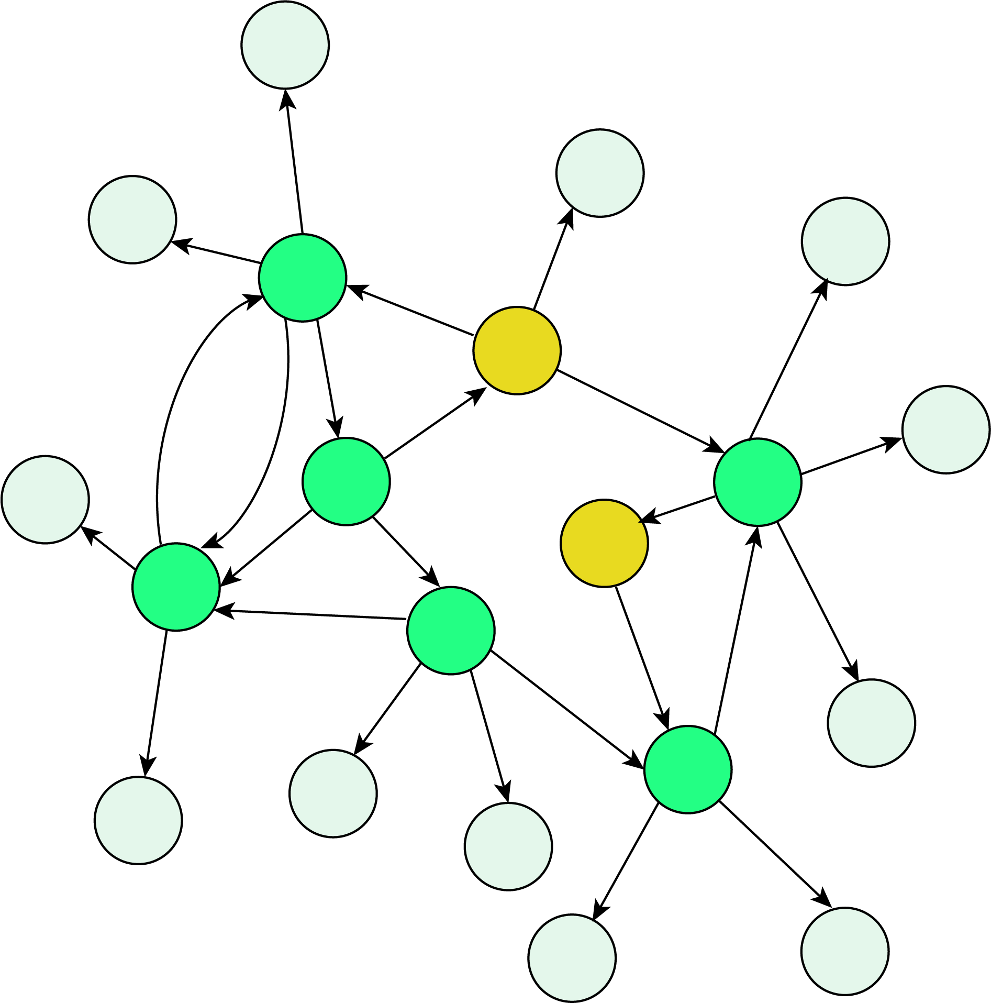
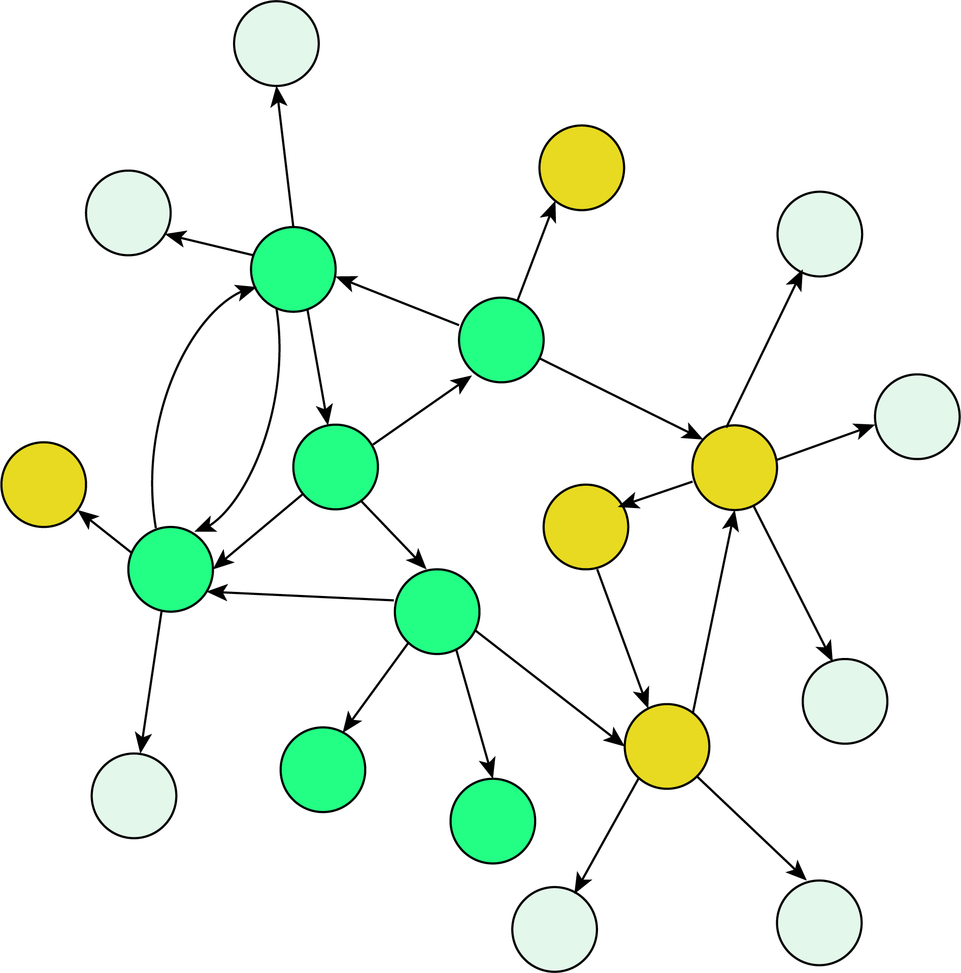
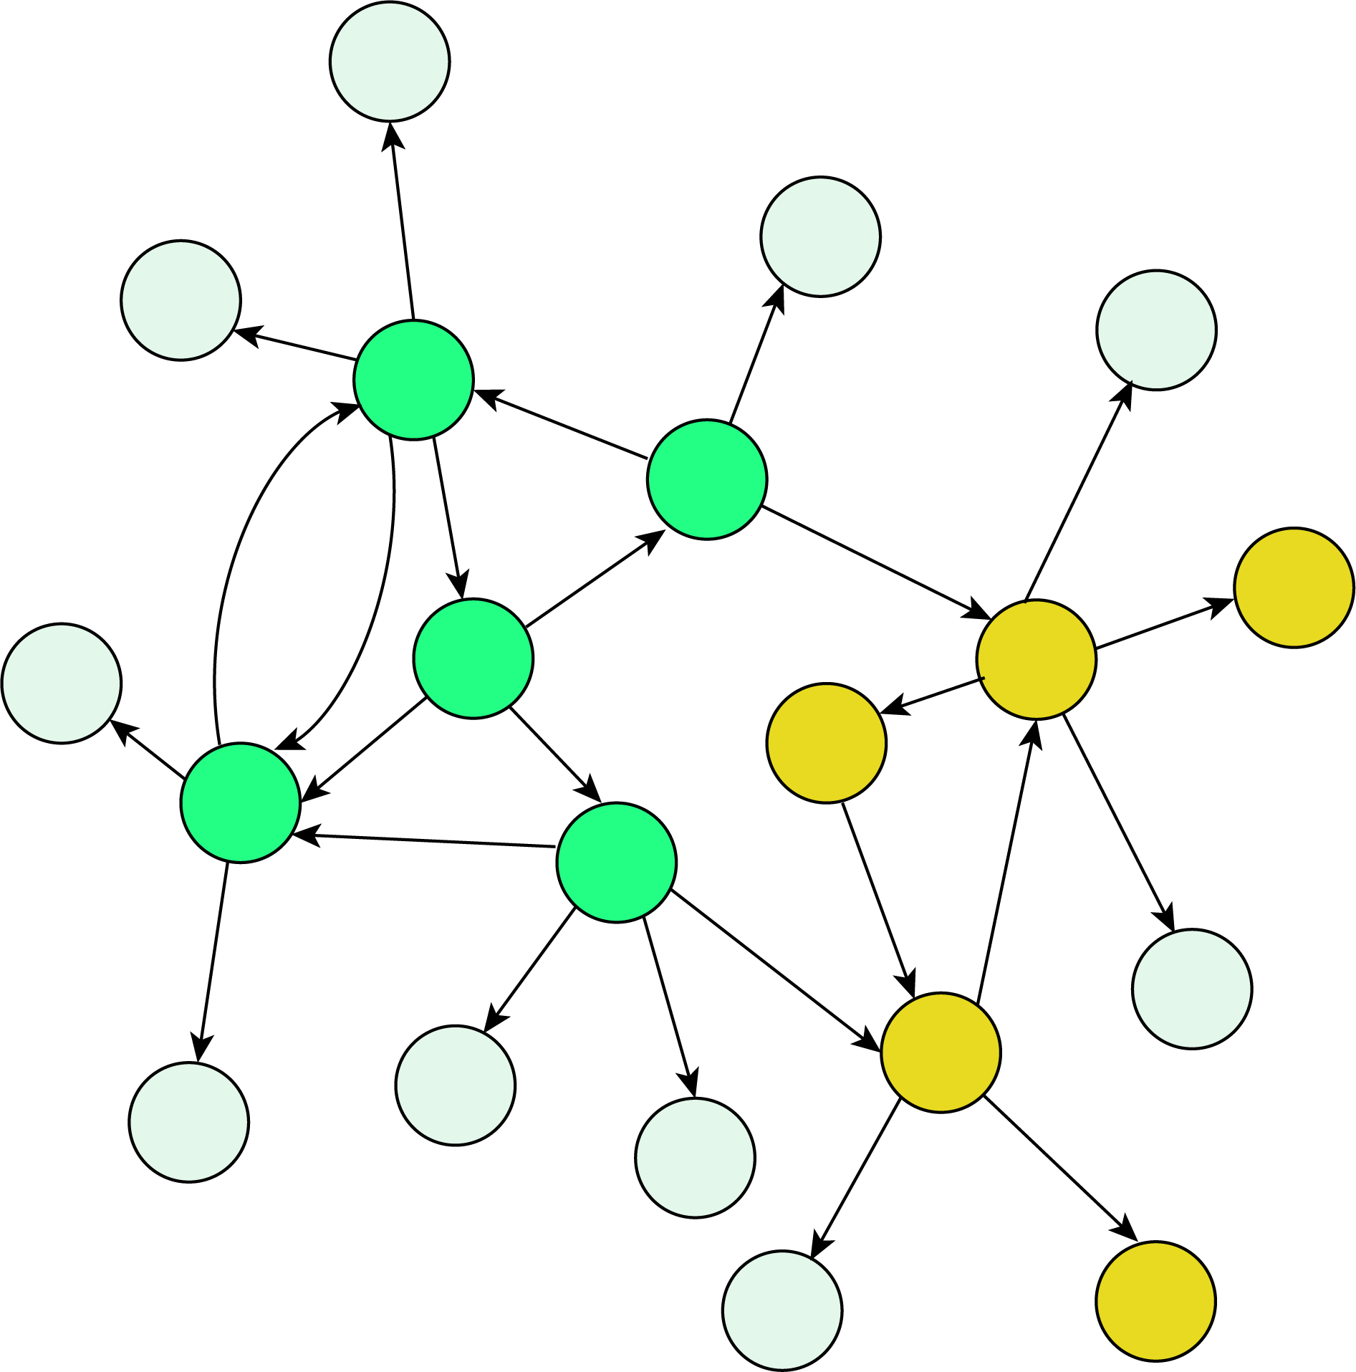
s(t₁)
State Space
s(t₂)
s(t₃)… s(t_{n-1})
s(t_{n})
Attractor State

Slide 13
State Space
s(t₁)
s(t₂)
s(t₃)… s(t_{n-1})
s(t_{n})
Attractor State

Slide 14
Identify Control Targets
Estimate
System Attractors
Structure-based Control Methods
Algorithms Such as SFA
Network Topology
Genes/Proteins/Molecules
Regulatory Edges sans Dynamics
Control Methods using Dynamics or Structure and Dynamics
Identify Control Targets
Multi-Omics Data
Literature Evidence
Experiments
Dynamical Model
System Dynamics
ODEs w/ Kinetic Parameters
Logic Formalisms
Simulate Using Model Dynamics
Identify System Attractors

Slide 15
Literature / Experiments
Multi-Omic Data
Dynamical Model (ODE, Boolean)
Intracellular Signaling Network
Control of Dynamical Systems
Attractor Landscape
Structure Based Control For non-linear systems
Prediction of network Dynamics
Identification of Reversion Targets
Identification of Reversion Targets

Slide 16
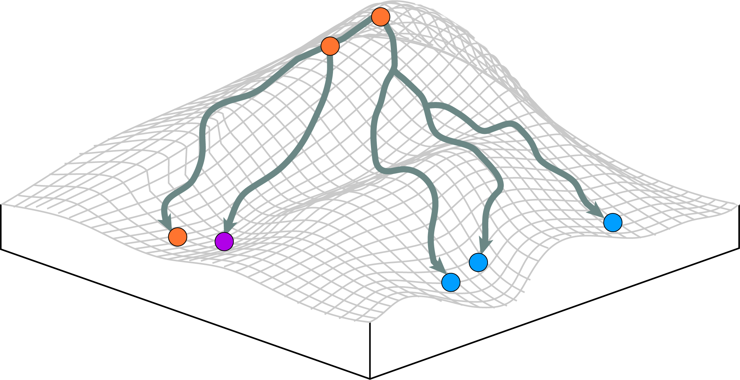
Unstable State
Initial State
“Potential” or stability of a state
Stable State = Mature Cell Type
Stable State =
Mature Cell Type
Stable State = Mature Cell Type

Slide 17
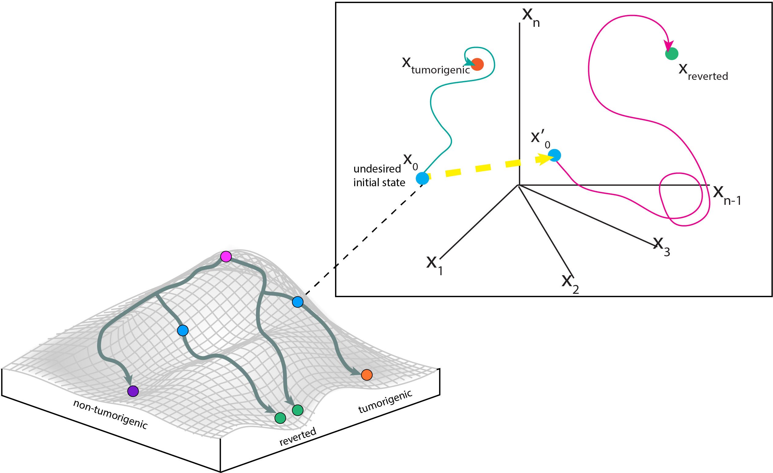

Slide 18
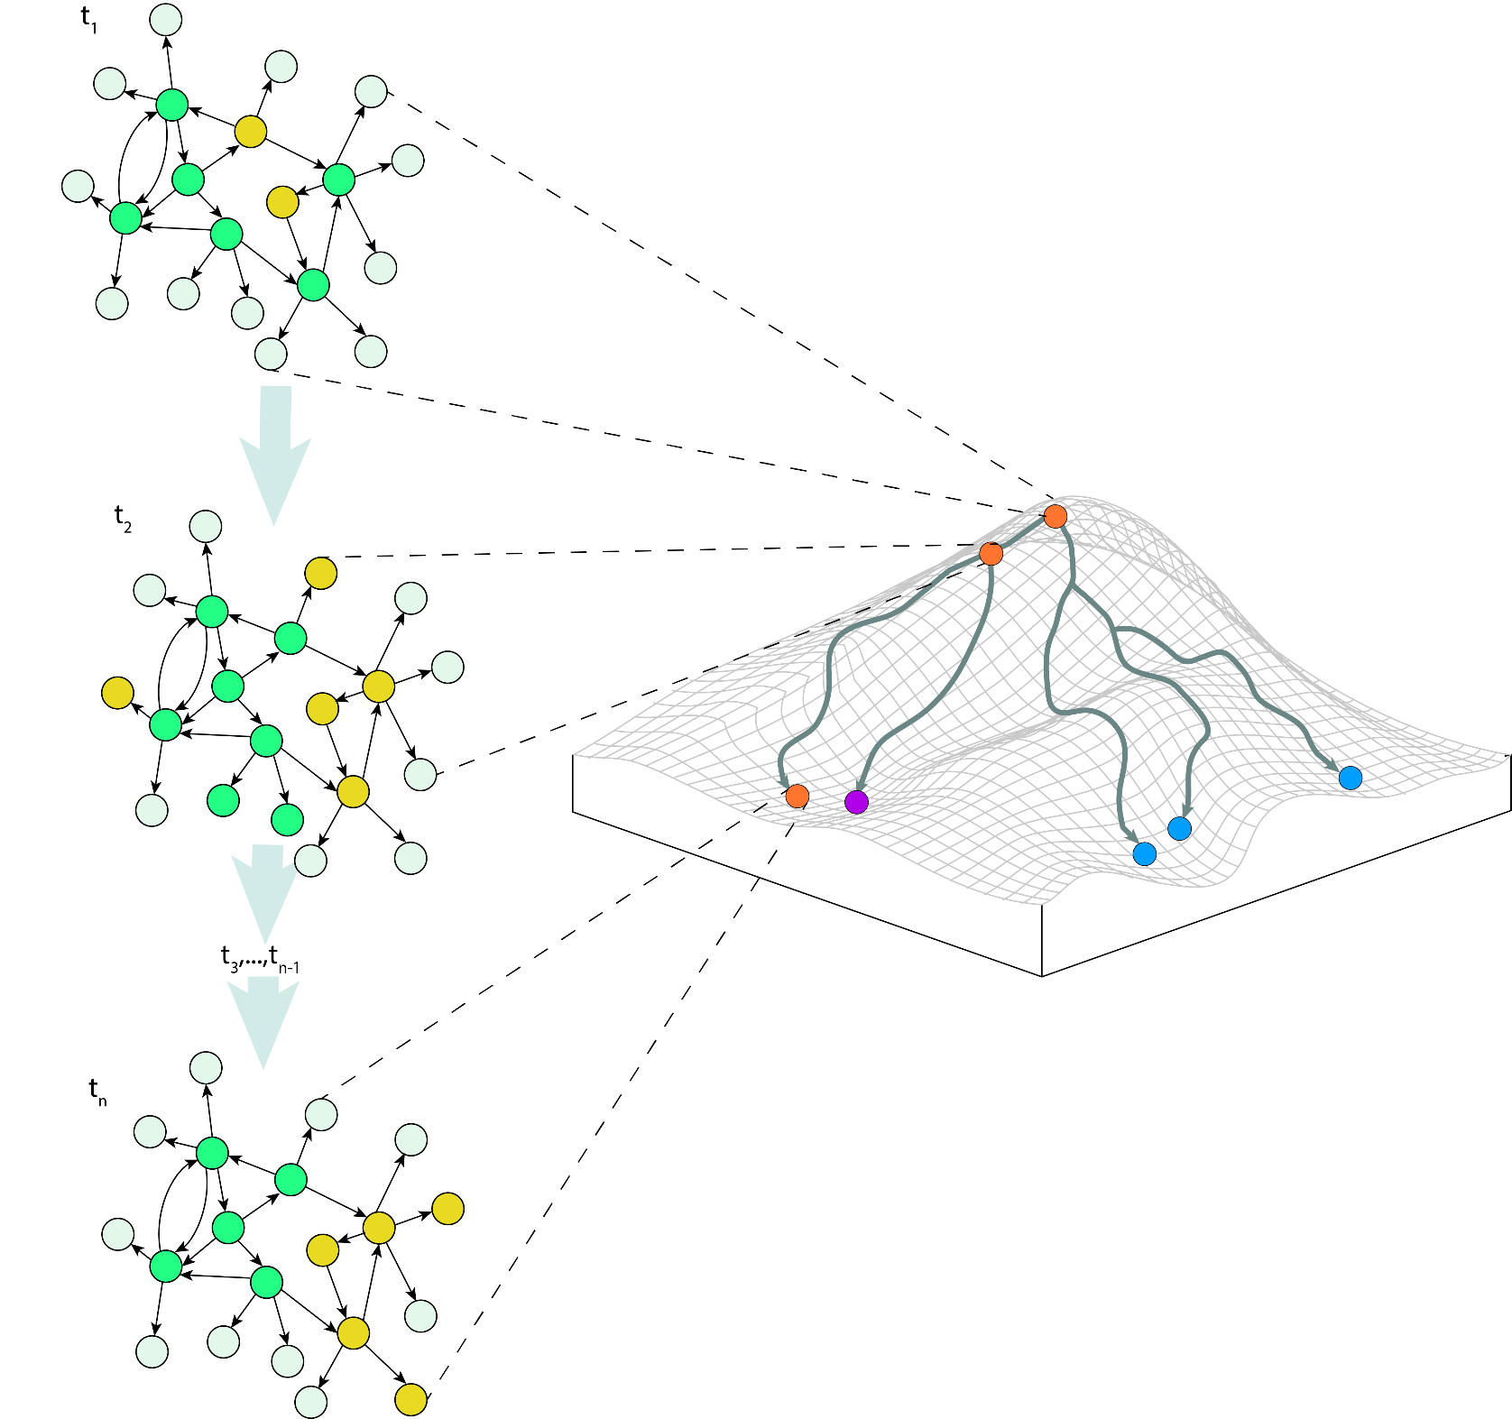

Slide 19
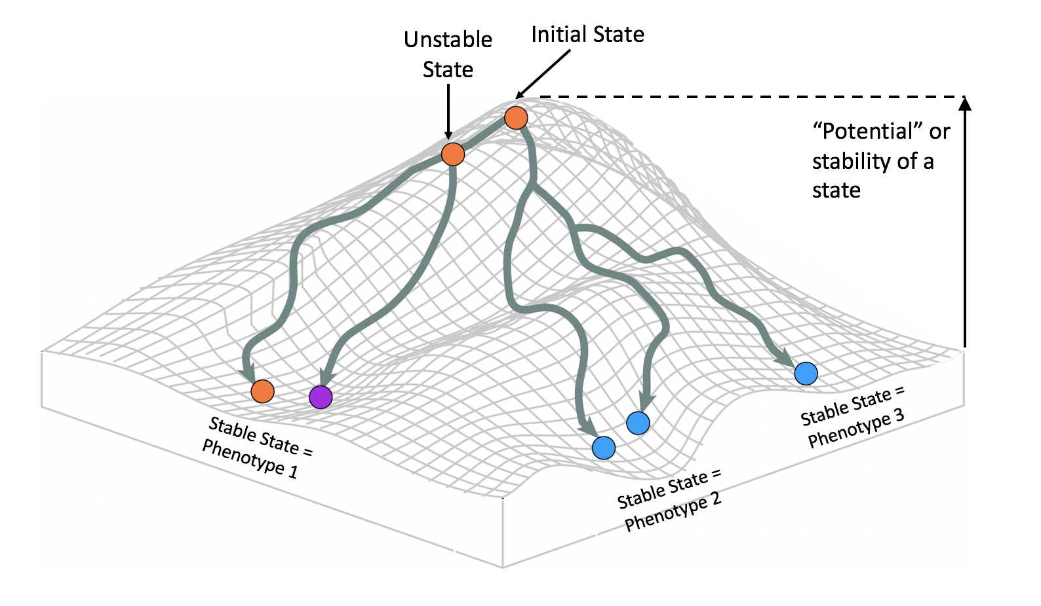

Slide 20
t₀
Initial State
Unstable State
t₁
“Potential” or stability of a state
t₂… t_{n-1}
Stable State = Phenotype 3
t_{n}
Stable State = Phenotype 1
Stable State = Phenotype 2

Slide 21
s(t₁)
Initial State
Unstable State
s(t₂)
Increase in
“Potential”
of a State
Increase in
Stability
of a State
s(t₃)… s(t_{n-1})
Attractor = Mature Cell Type
s(t_{n})
Attractor = Mature Cell Type
Attractor = Mature Cell Type

Slide 22
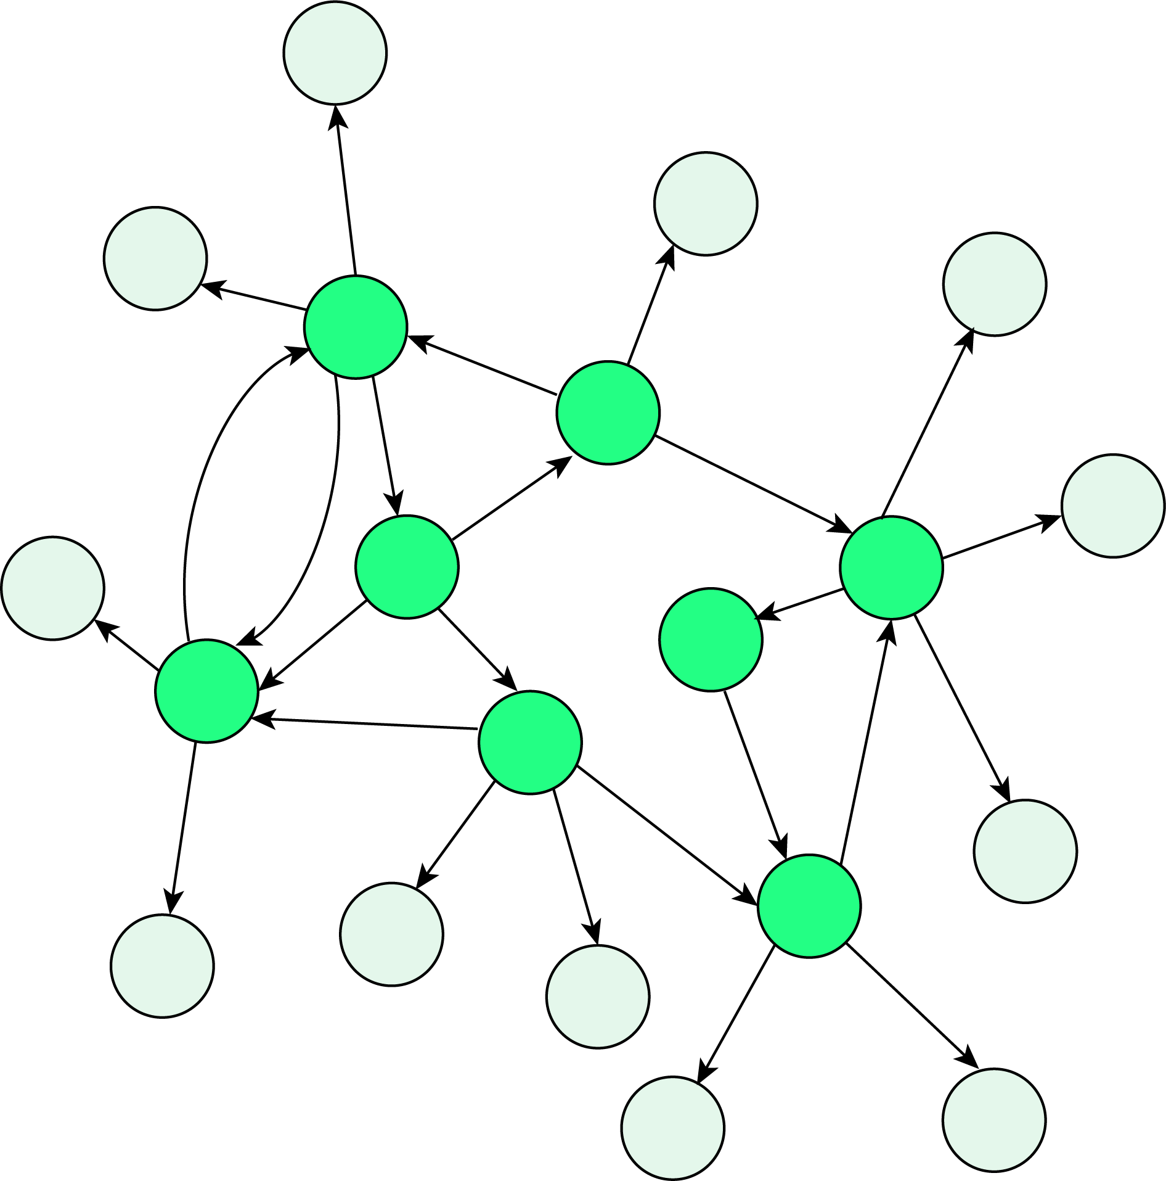

Slide 26
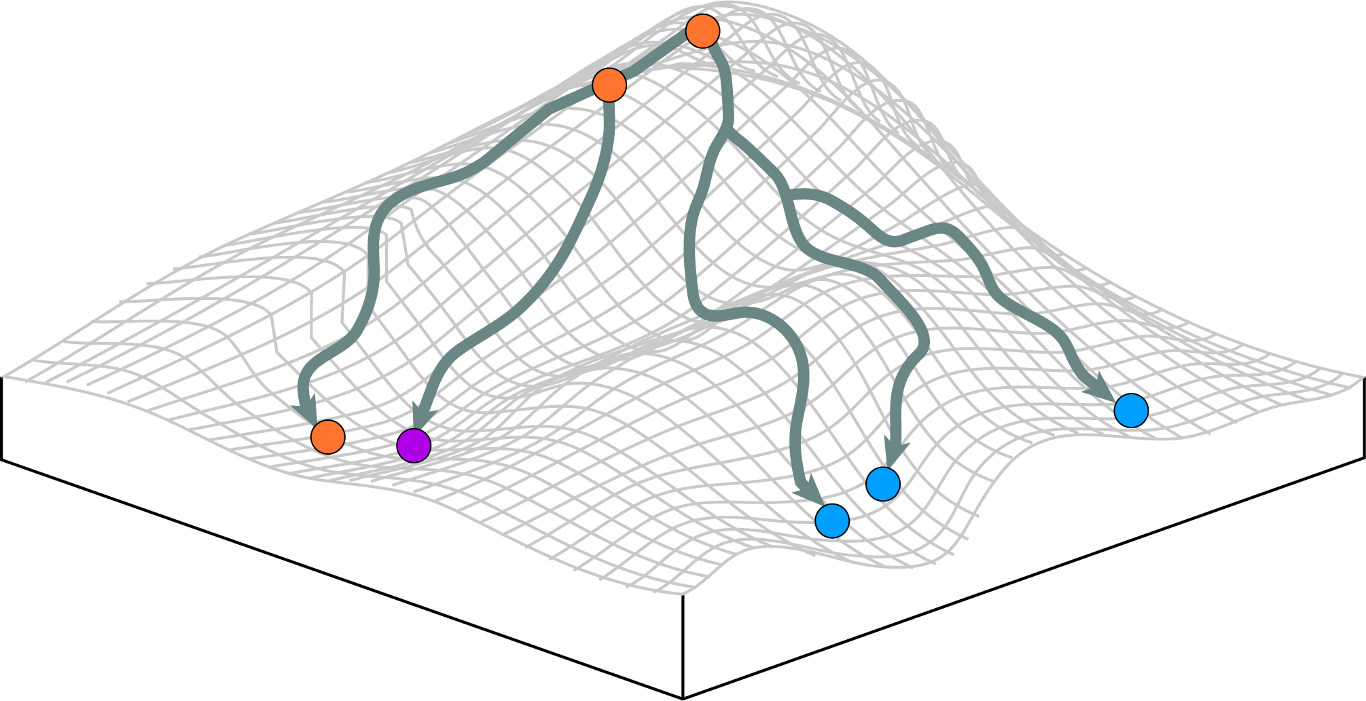

Slide 27
Methods

Slide 28


Slide 29
